Slide 1



REPORTING NON-FINANCIAL PERFORMANCE- SUSTAINABILITY REPORTING & CURRENT ISSUES IN FINANCIAL REPORTING
Bachelor of Accounting & Finance (Hons)
FIN2224 Financial Accounting 2

Slide 2
ENVIRONMENTAL REPORTING
The aim of environmental reporting is the disclosure of an organization’s corporate environmental responsibilities and the effects of its activities on its environment
The growing awareness within general population of environmental issues plus pressure from NGOs has led to the expectation that PLC to disclose this matters.

Slide 3
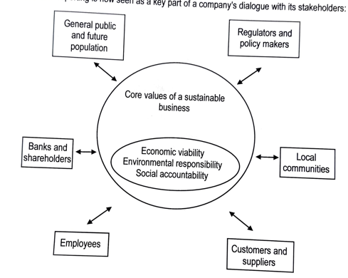

Slide 4
SOCIAL REPORTING
The aim of social reporting is to measure and disclose the social impact of a business’ activities.
Examples of social measures include:-
Philanthropic donations
Employee satisfaction levels and remuneration issues
Community support; and
Stakeholder consultation information

Slide 5
BENEFITS OF ENVIRONMENTAL & SOCIAL REPORTING
It demonstrates the coherence of overall management strategy to important external stakeholders
It strengthens stakeholder relations
It increase competitive advantage
Public recognition for corporate accountability and responsibility
Target setting and external reporting drives continual environmental and social improvements
Effective self-regulation minimize risk of regulatory intervention
It may improve access to lists of ‘preferred suppliers’ of buyers with green procurement policies
It reduces corporate risk, which may reduce financing costs and broaden the range of investors
It enhance employee morale
Improved profitability

Slide 6
CURRENT REPORTING REQUIREMENTS
IFRS requirements
There is no required disclosure requirements for environmental and social matters
However, environmental matters may be disclosed where they fall under specific accounting principles:
IAS 37 Provisions, Contingent Liabilities, and Contingent Assets
IAS 1 Presentation of Financial Statements
2. National requirements
Some countries require disclosure of environmental performance under the national law.
Environmental Quality Act (EQA) 1974 is the primary legislation governing environmental protection in Malaysia. It establishes the legal framework for preventing, abating, and controlling pollution and managing the environment.
Sustainability Framework: The Bursa Malaysia Sustainability Reporting Framework aligns with global standards such as the Global Reporting Initiative (GRI)

Slide 7
CURRENT REPORTING REQUIREMENTS (cont.)
3. Voluntary Disclosure
4. Sustainability Reporting
Initial disclosure of environmental matters has now expanded into sustainability reporting which integrates environmental, social, and economic performance data and measures
Global Reporting Initiatives https://www.globalreporting.org/how-to-use-the-gri-standards/gri-standards-english-language/
.

Slide 8
Human Capital Accounting
The core principle is that employees are assets.
Competitive advantage gained by effective use of people.
Implications of PEOPLE as ORGANISATIONAL ASSETS:-
People are a resource which needs to be careffuly and efficiently managed with overriding concern for organizational objectives
The organization needs to protect its investment by retaining, safeguarding, & developing its human assets
Deterioration in the attitudes and motivation of employees increases in the labor turnover, cost of hiring, and training replacements are costs to the company
A concept developed some time ago was that of human asset accounting (part of financial reporting system)

Slide 9
Intellectual Assets
The concept of human assets broadened and become INTELLECTUAL ASSETS which is also known as INTELLECTUAL CAPITAL, divided into 3 types:-
External Assets – Reputation of brands & franchises, and strength of customer relationships
Internal Assets – Patents, Trademarks, Customer Databases
Competencies – Capabilities & Skills of individuals
#Intellectual assets= human assets

Slide 10
INTEGRATED REPORTING <IR>
INTEGRATED REPORTING
A process on the value creation over time and related communications regarding aspects of value creation
INTEGRATED REPORT
A concise communication on organization’s strategy, governance, performance, and prospects, in the context of its external environment, lead to creation of value over the short, medium, & long term

Slide 11
OBJECTIVES OF <IR>
Improve the quality of information available to providers of financial capital to enable a more efficient and productive allocation of capital
Promote a more cohesive and efficient approach to corporate reporting & communicates the ability of the organization to create value over time
Enhance accountability and stewardship with broad base of capitals (financial, intellectual, human etc.)
Support integrated thinking, decision-making and actions that focus on the creation of value in short, medium, & long term

Slide 12
References
BPP Environmental & Social Reporting Notes
Additional Reading such as Bursa Malaysia & Global Reporting Standards
https://www.globalreporting.org/how-to-use-the-gri-standards/gri-standards-english-language/

